Slide 1
Comparative Sentiment Analysis on Twitter Data
By:
Thilok Reddy Anugu & Sree Chandana Kurella

Slide 2
Contents
Introduction
Problem Statement
Objectives
Approach & Implementation
Experiments & Observations
User Interaction
Conclusions / Roadmap
References

Slide 3
Introduction
Sentiment analysis has become increasingly crucial in understanding public opinion, especially with the wealth of data available on social media platforms like Twitter.
In our project, we focus on Twitter data, employing various models—Naïve Bayes, Logistic Regression, Decision Tree, SVM, Random Forest, VADER, and BERT—to analyse sentiments efficiently.
Our goal is to extract valuable knowledge from Twitter feeds
Through our comparative study, we aim to determine the most effective model for sentiment

Slide 4
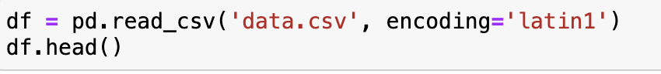
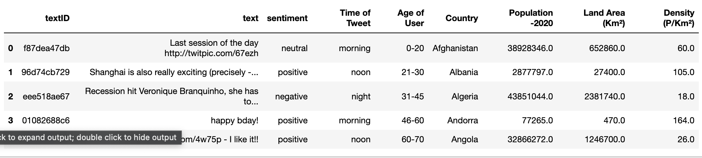
The dataset

Slide 5
Problem Statement
Despite the vast amount of data available on Twitter, effectively extracting sentiment remains a challenging task. The inherent noise, brevity, and informal nature of tweets make sentiment analysis a complex problem. Traditional methods often struggle to capture the nuances and context-dependent nature of language in this dynamic platform.
The need for sentiment analysis on Twitter arises from the desire to comprehend public opinion, track brand perception, and identify emerging trends. Analyzing sentiments in tweets can help businesses make data-driven decisions, policymakers gauge public sentiment on relevant issues, and researchers understand the ever-changing landscape of online discourse.

Slide 6
Objectives
Explore and analyse sentiment in Twitter data: Investigate the challenges associated with sentiment analysis on Twitter, considering the unique characteristics of the platform.
Evaluate and compare multiple machine learning models: Assess the performance of various models, including Naive Bayes, Logistic Regression, Decision Tree, Support Vector Machine, Random Forest Classifier, VADER, and BERT, to identify the most effective approach for sentiment analysis on Twitter.
Provide a comprehensive solution: Develop a robust sentiment analysis pipeline that incorporates the strengths of different models, aiming to enhance accuracy and reliability in capturing diverse sentiments expressed in tweets.

Slide 7
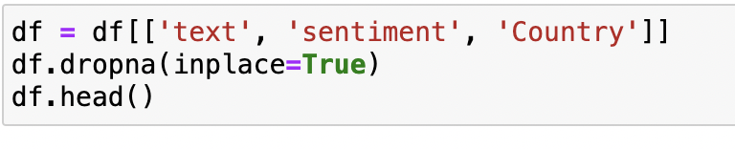
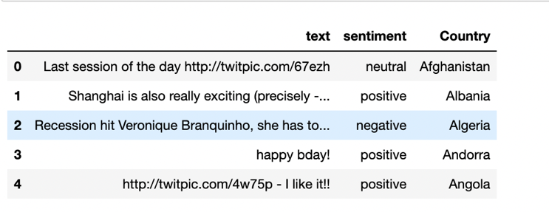
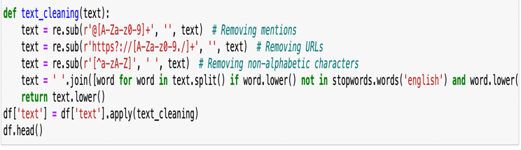
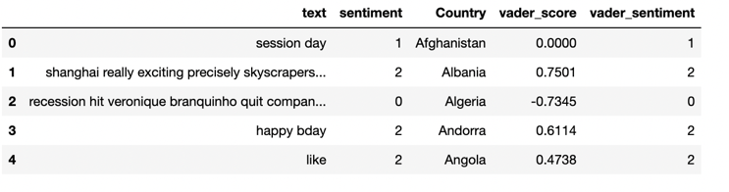
Approach & Implementation
Data Preprocessing
Data preprocessing is a crucial step to ensure the quality of the Twitter data for effective sentiment analysis. The preprocessing steps include:
Text Cleaning: Removal of mentions, URLs, and non-alphabetic characters from the tweets.
Stopword Removal: Elimination of common and custom stopwords to filter out noise.

Slide 8
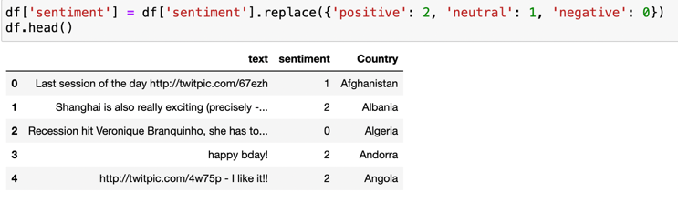
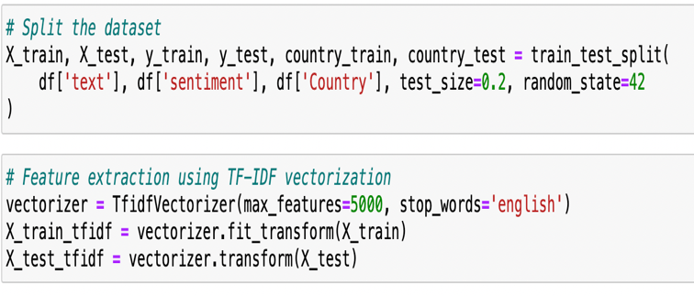
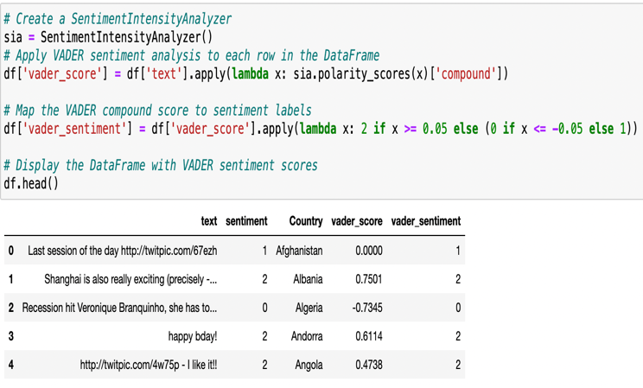
Approach & Implementation
Sentiment Labeling
A three-class sentiment labeling scheme was adopted for supervised learning: 0 for negative, 1 for neutral, and 2 for positive sentiment.
Feature Extraction
TF-IDF Vectorization: Utilization of TF-IDF (Term Frequency-Inverse Document Frequency) vectorization for converting preprocessed text data into numerical features, capturing term importance relative to the entire dataset.
VADER Sentiment Analysis: Integration of the VADER tool for sentiment analysis, assigning compound scores to tweets based on predefined thresholds.

Slide 9
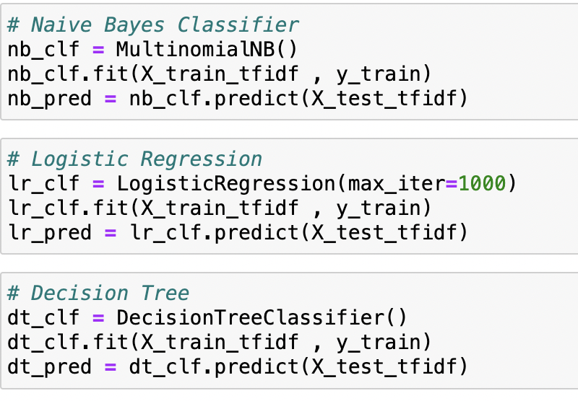
Approach & Implementation
Model Selection
Naive Bayes is considered for its ability to handle high-dimensional data efficiently. The algorithm computes the probability of a tweet belonging to a particular sentiment class, making it particularly useful for quick and effective sentiment classification.
Logistic Regression is chosen as it is suitable for modeling binary outcomes, making it applicable for sentiment classification tasks. Its ability to provide probabilities allows for a nuanced understanding of sentiment strength.
Decision Trees are employed for their ability to capture non-linear relationships in data. In sentiment analysis, they can uncover complex patterns that linear models might miss, providing a more comprehensive understanding of sentiment.

Slide 10
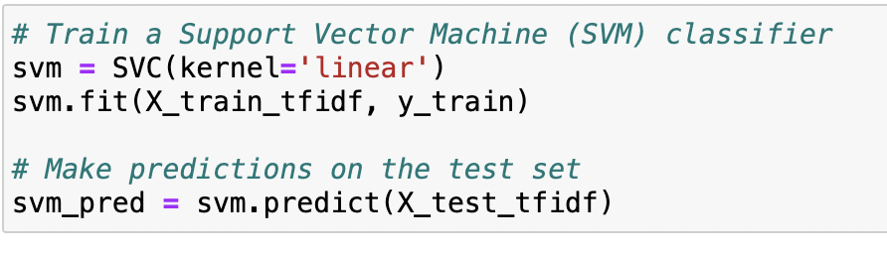
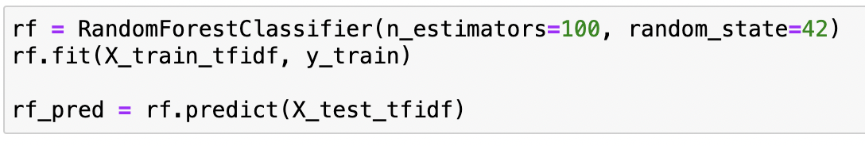
Approach & Implementation
Model Selection
Support Vector Machine (SVM): Employment of a linear Support Vector Machine (SVM) as a primary classifier due to its effectiveness in handling high-dimensional data. SVM identifies the optimal hyperplane for separating data into distinct sentiment classes.
Random Forest Classifier: Utilization of the Random Forest Classifier, an ensemble learning method, to harness the collective predictive power of multiple decision trees. This approach enhances model robustness and generalizability.
BERT Model: Integration of the BERT model, a powerful transformer-based architecture, for enhanced sentiment analysis. The BERT model achieved a notable accuracy of 79%, surpassing other models.

Slide 11
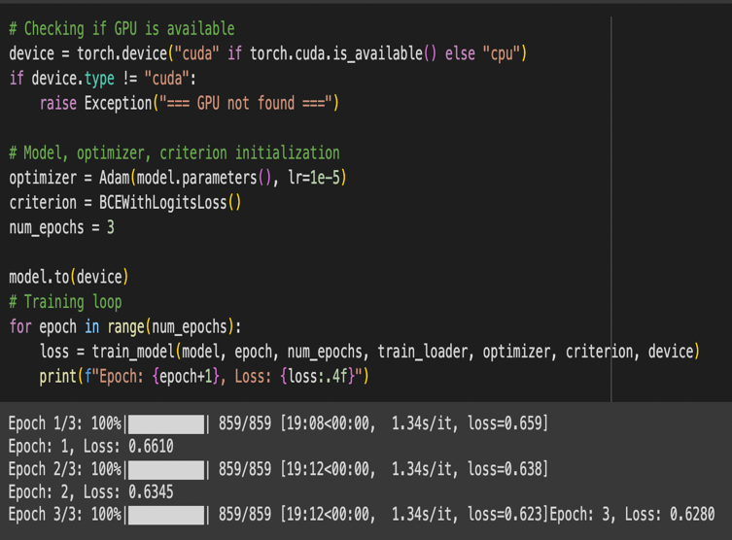
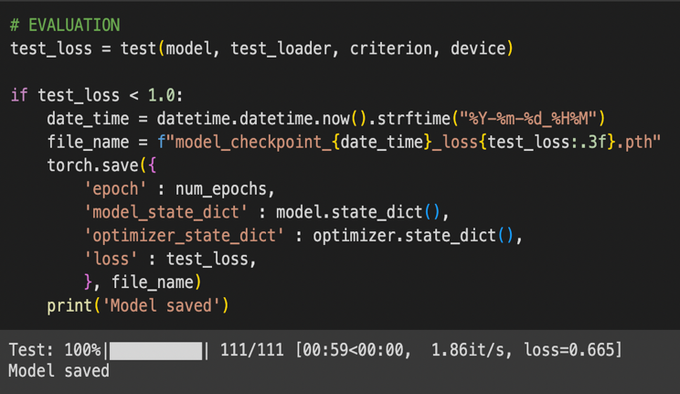
Approach & Implementation
BERT

Slide 12
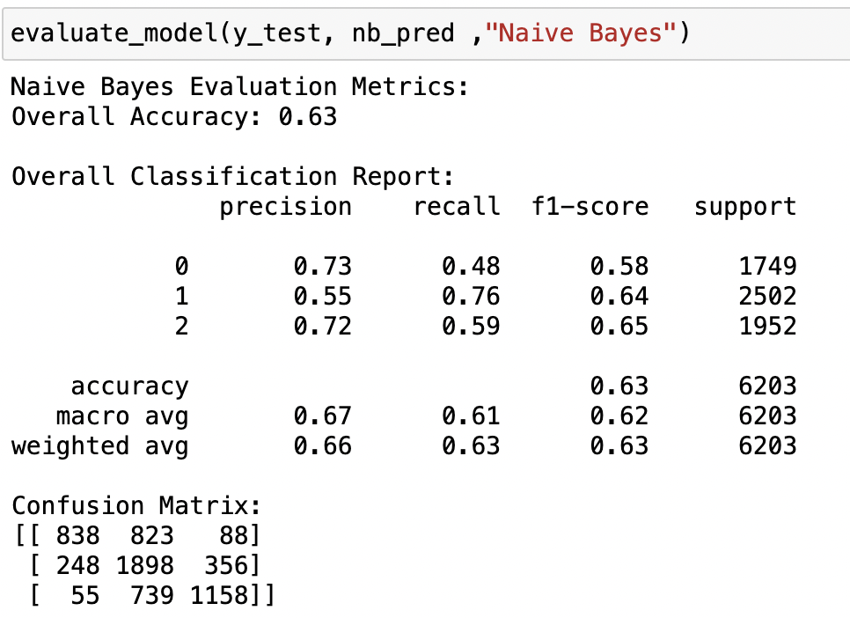
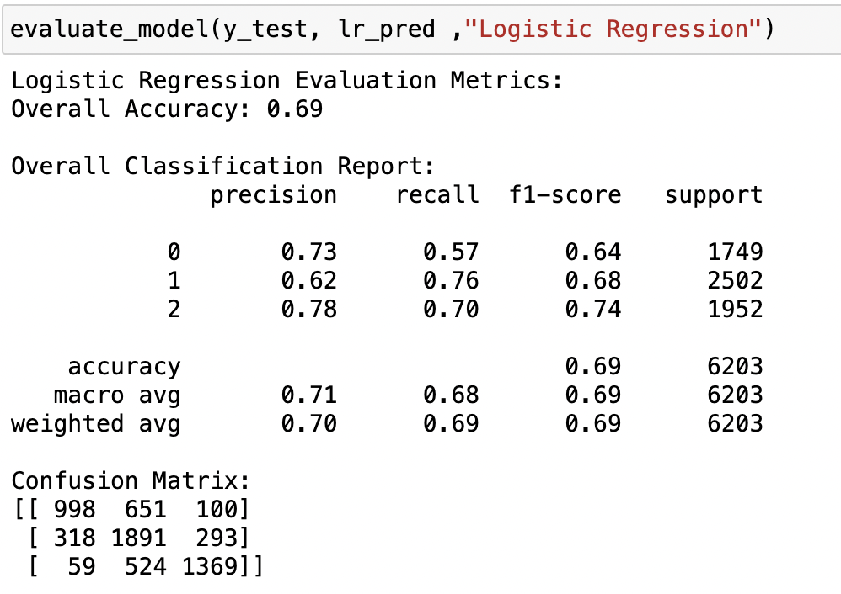
Experiments & Observations
Model Evaluation:
Naïve Bayes
Logistic Regression

Slide 13
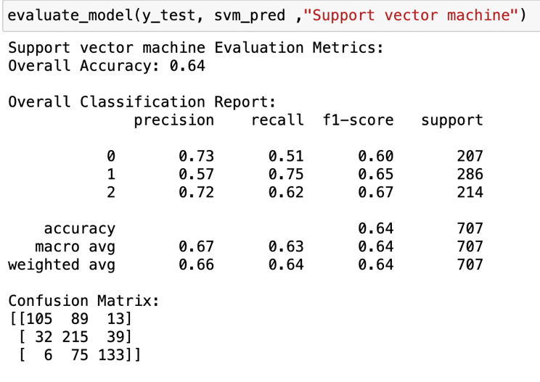
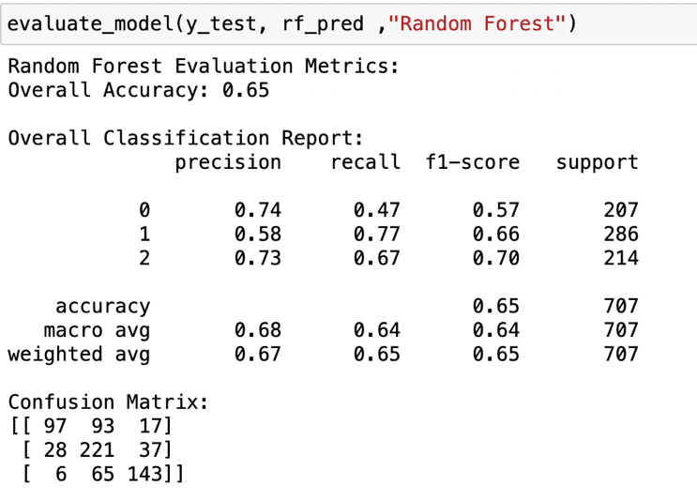
Experiments & Observations
Model Evaluation:
Support Vector Machine
Random Forest Classifier

Slide 14
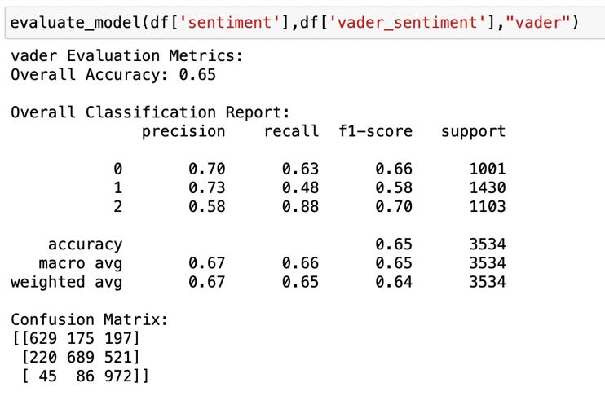
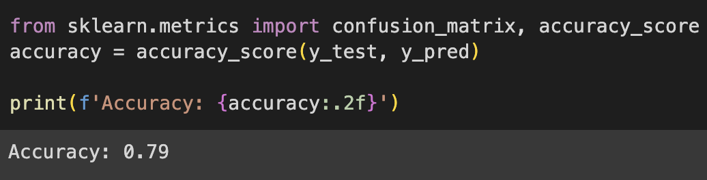
Experiments & Observations
VADER
BERT

Slide 15
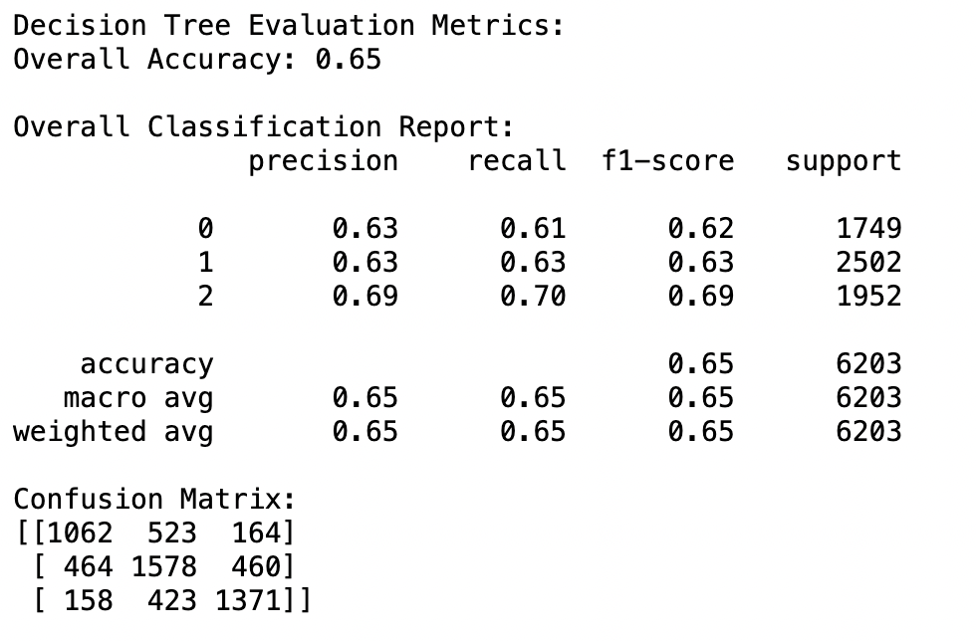
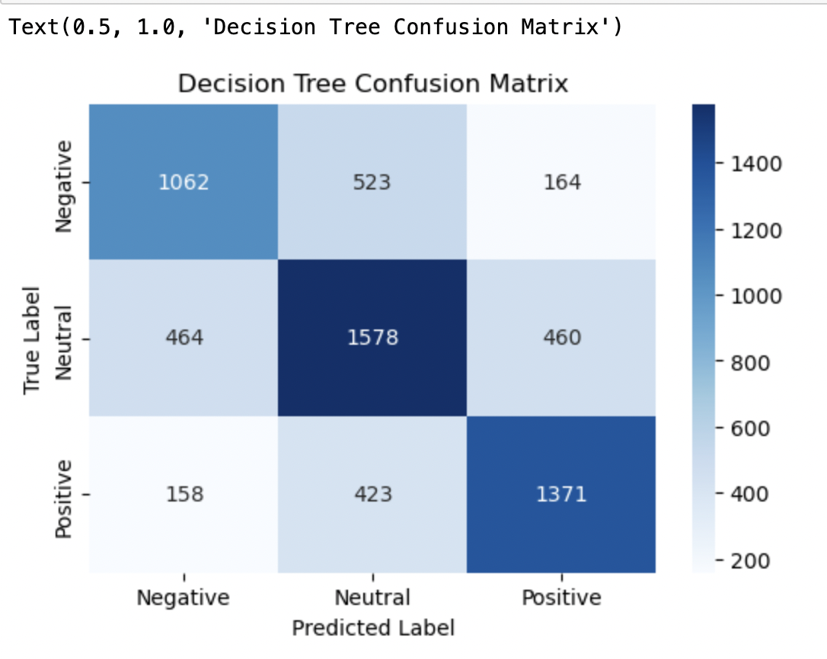
Experiments & Observations
Model Evaluation:
Confusion Matrix

Slide 16
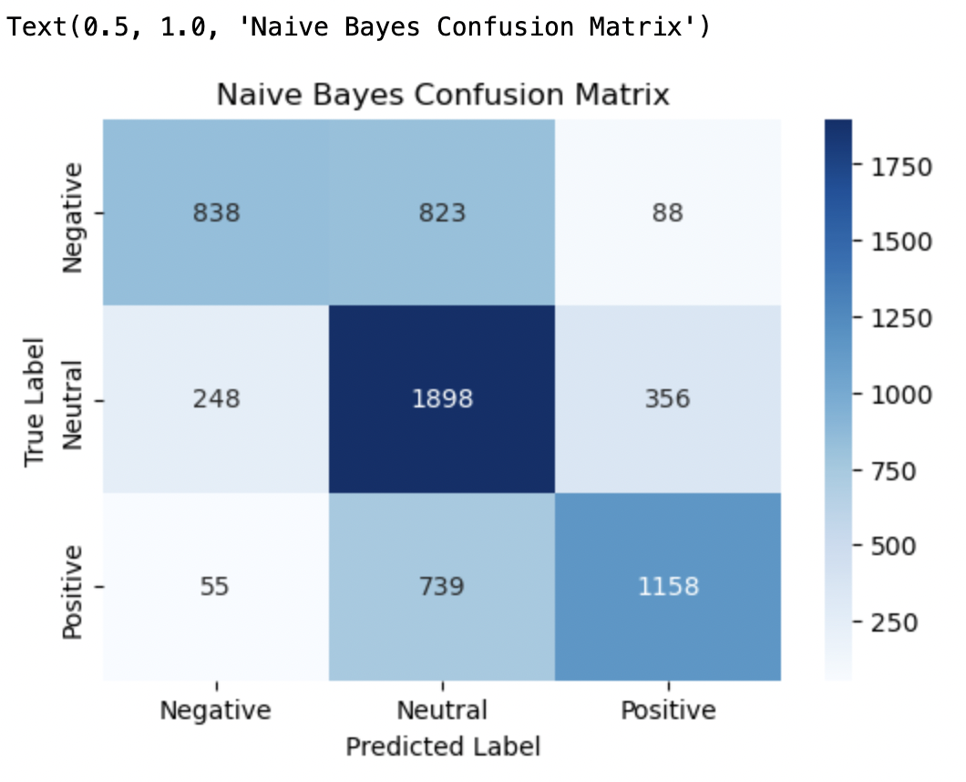
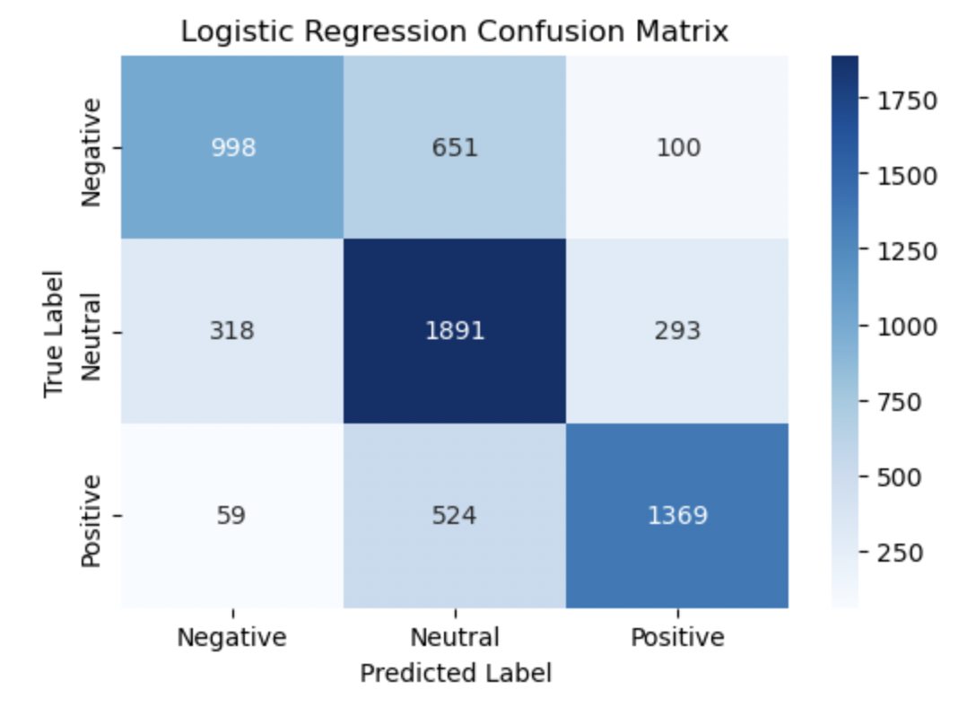
Experiments & Observations
Confusion Matrix
Naïve Bayes
Logistic Regression

Slide 17
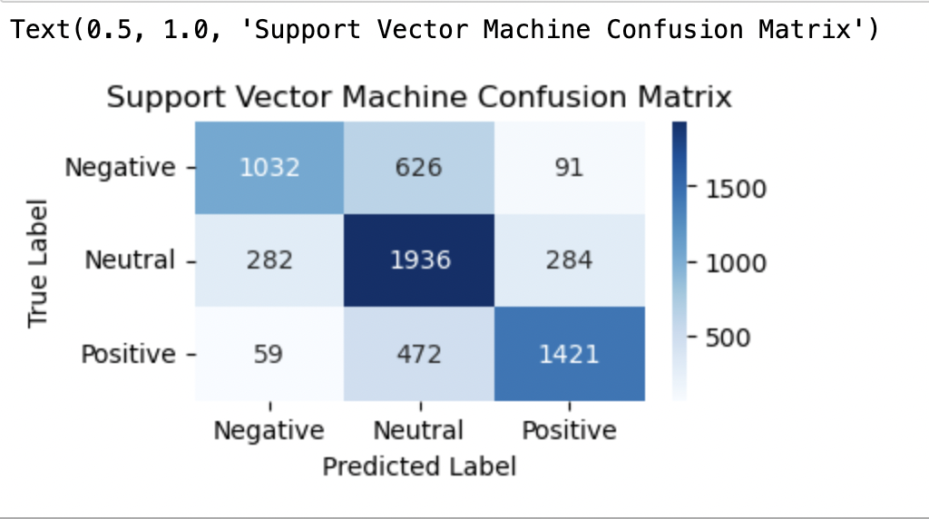
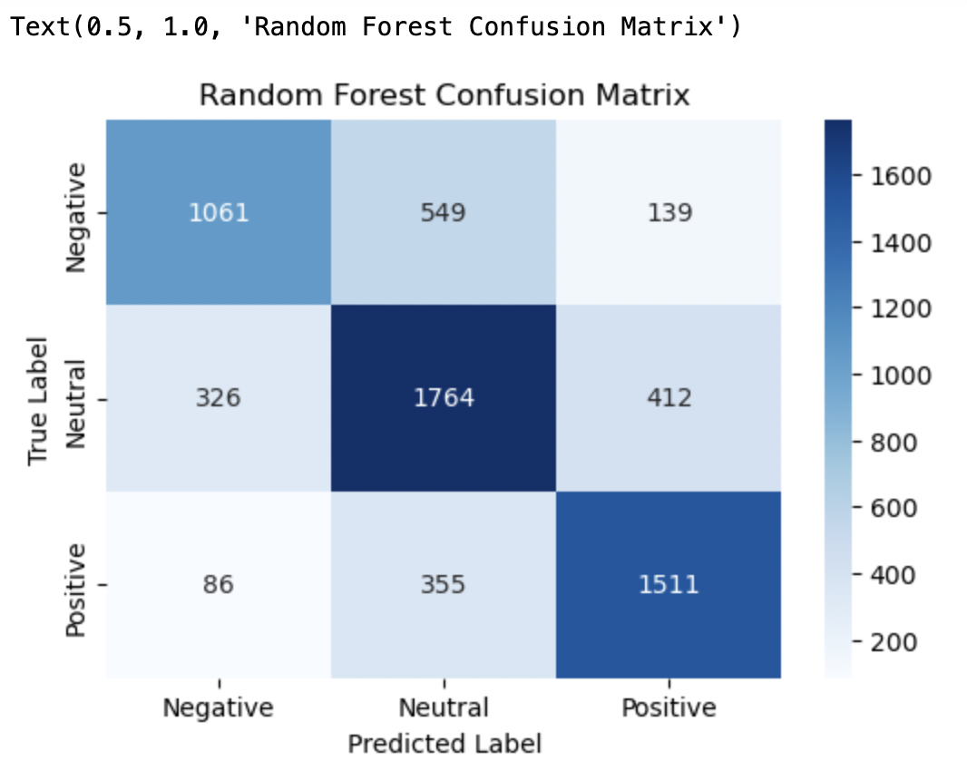
Experiments & Observations
Confusion Matrix
Support Vector Machine
Random Forest Classifier

Slide 18
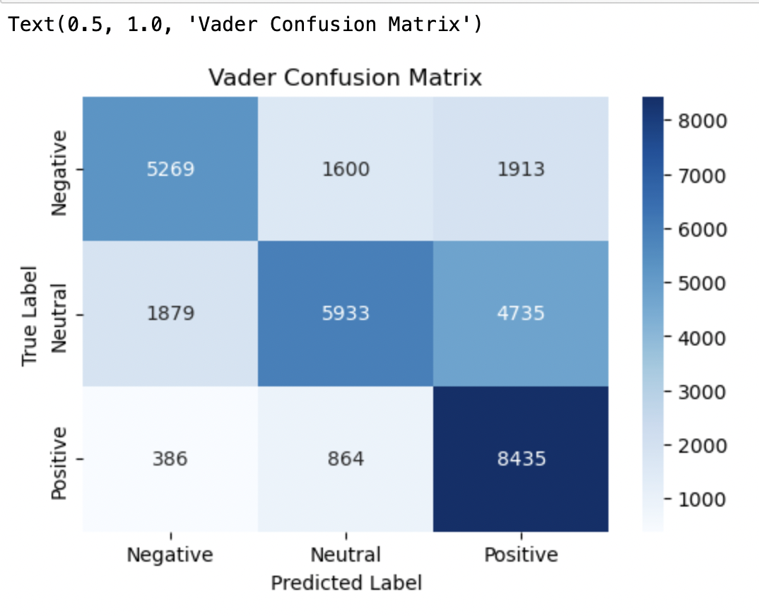
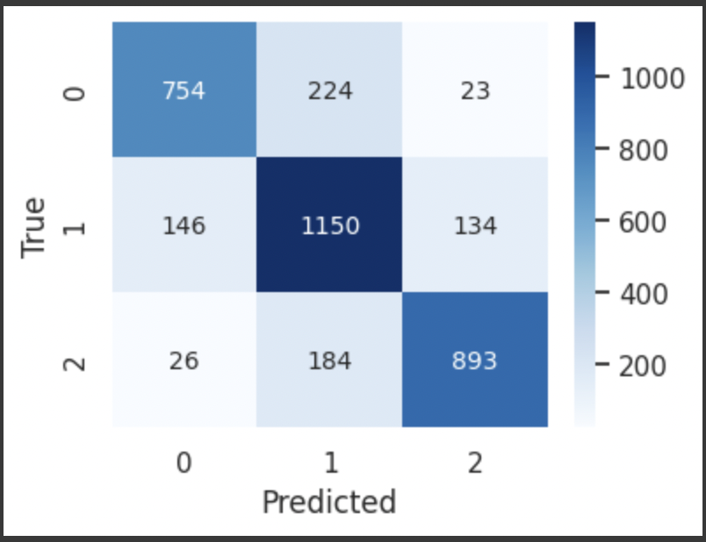
Experiments & Observations
VADER
BERT

Slide 19
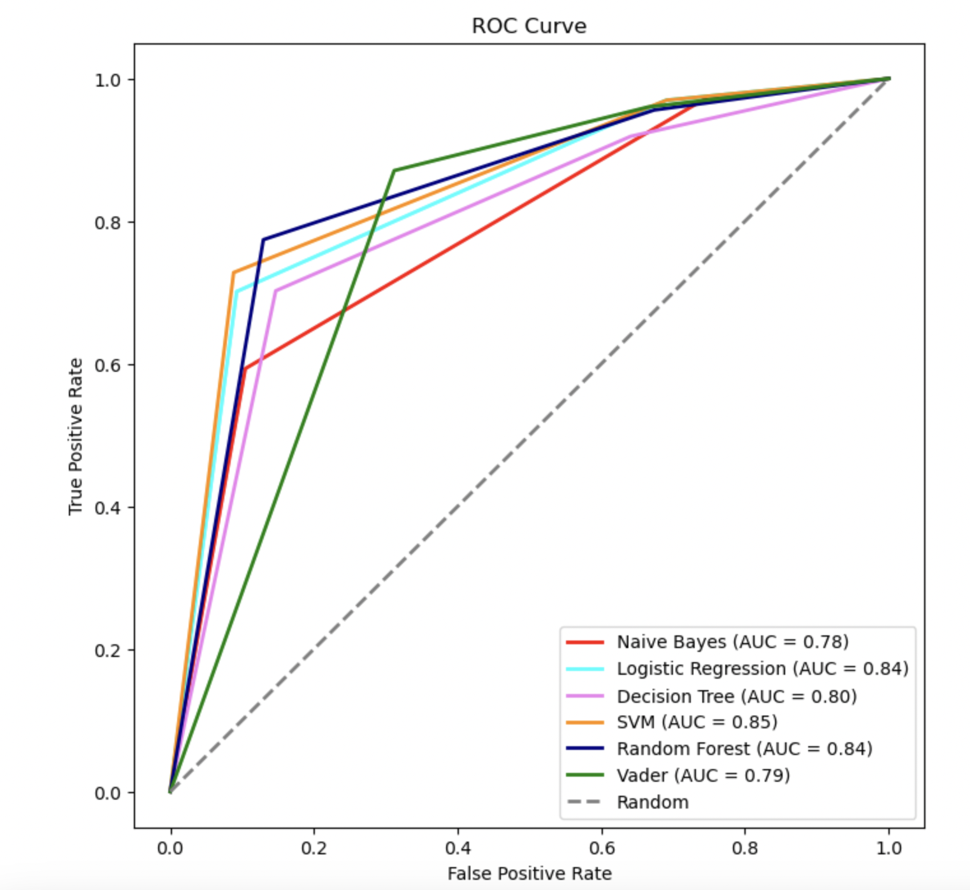
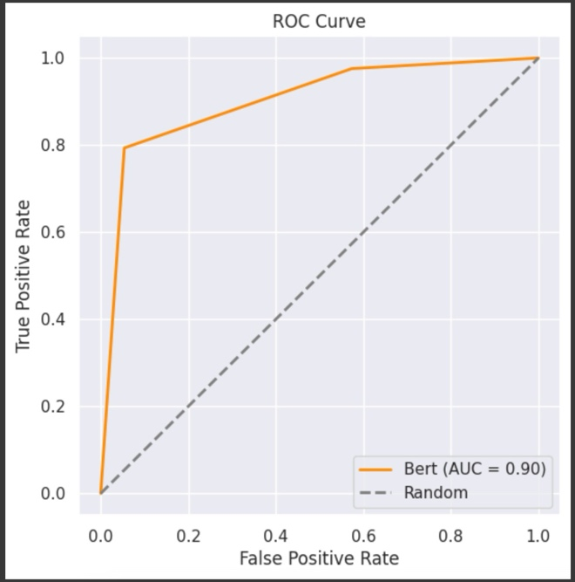
Experiments & Observations
ROC AUC Curves
BERT

Slide 20
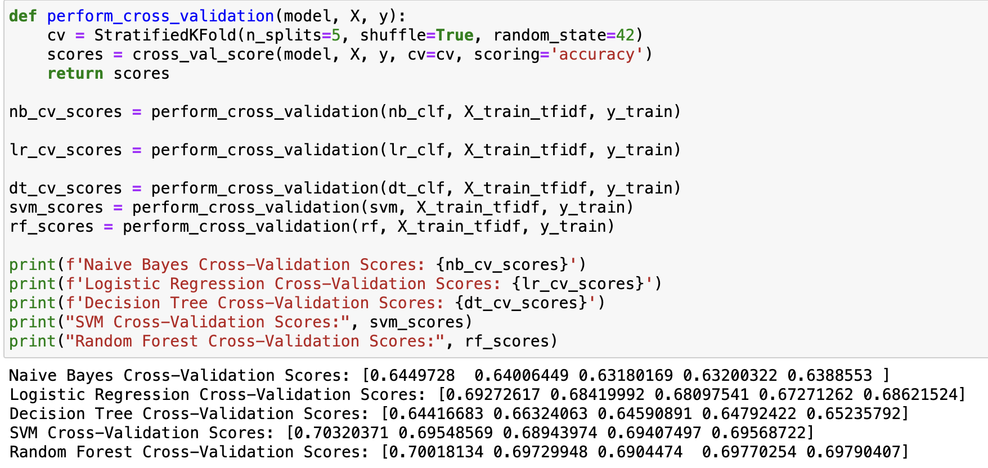
Experiments & Observations
Cross Validation
Naïve Bayes and Decision Tree Classifier indicate a moderate level of accuracy in capturing the sentiment patterns.
The SVM and Random Forest models demonstrated higher scores, suggesting strong performance in capturing sentiment compared to Naive Bayes, Logistic Regression, and Decision Trees.

Slide 21
Observations
The BERT model's superior performance can be attributed to its ability to capture the contextual nuances in Twitter data. Unlike traditional models, BERT considers the relationships between words, resulting in more accurate sentiment predictions.
SVM and Random Forest models maintained their standout performance, not only in cross-validation but also in overall accuracy, making them robust choices for sentiment analysis on Twitter data.
Logistic Regression, Decision Trees, and Naive Bayes, while having slightly lower accuracy scores, still demonstrated competency and contribute valuable insights to the sentiment analysis pipeline.

Slide 22
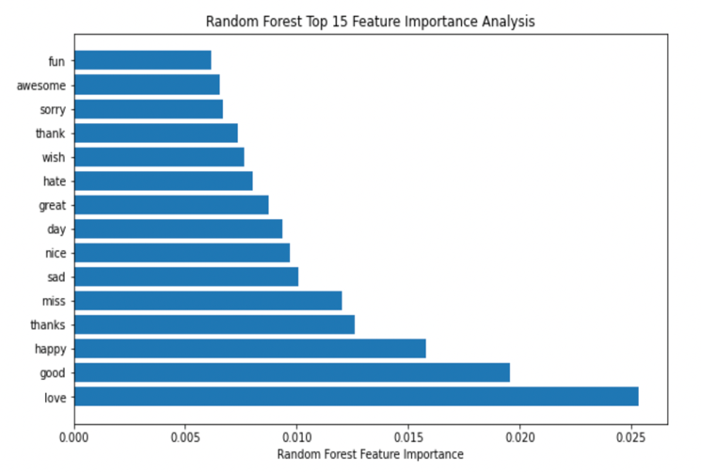
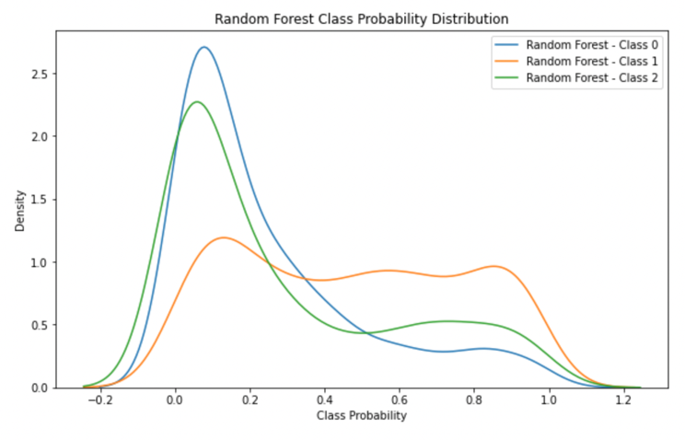
Experiments & Observations
Random Forest Classifier
Feature Importance Graph
Class Probability Distribution Graph

Slide 23
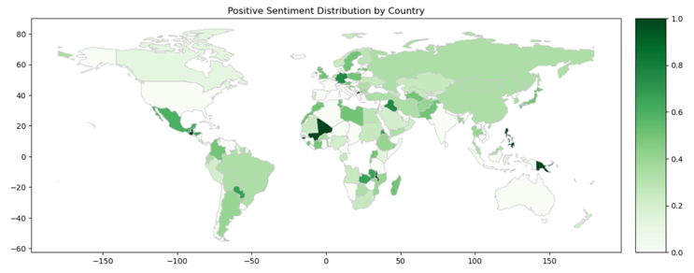
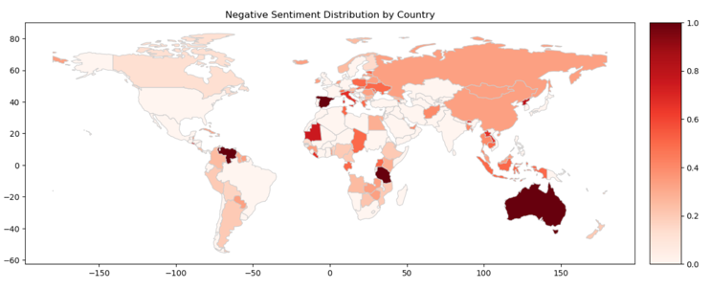
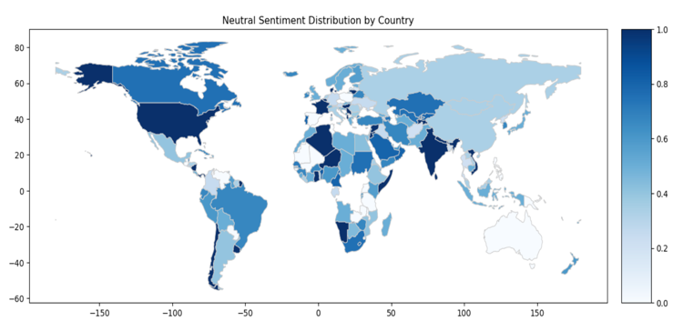
Experiments & Observations
Geographical Sentiment Distribution Analysis

Slide 24
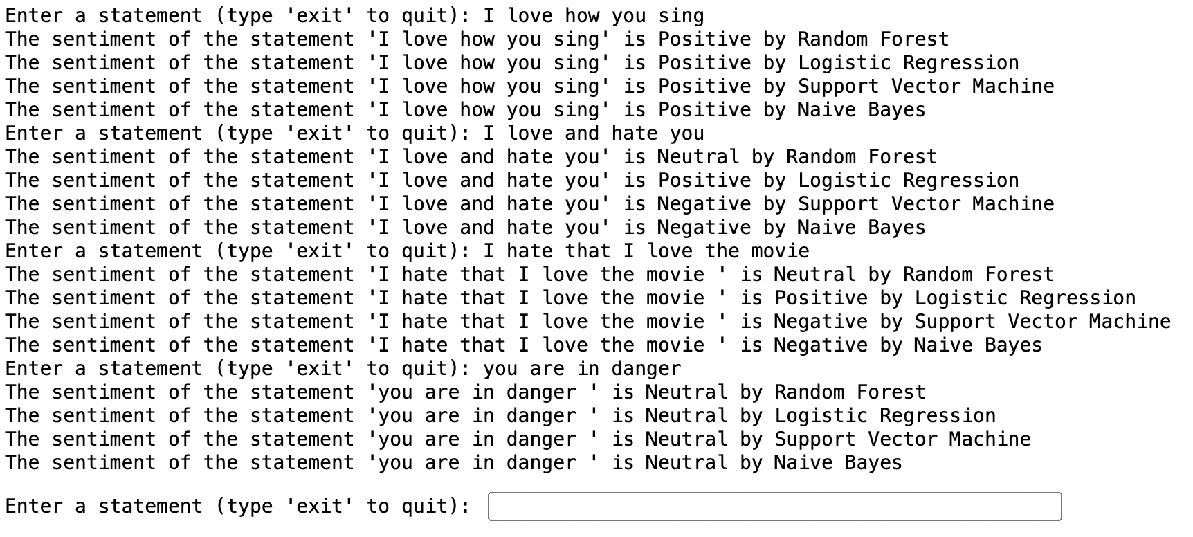
User Interaction/ Demo

Slide 25
Conclusions
BERT Model Excellence: The BERT model emerged as the most effective, boasting an impressive accuracy of 79%. Its nuanced understanding of contextual relationships within tweets sets it apart for sentiment analysis tasks.
AUC Analysis: BERT's superior performance is further underscored by its Area Under Curve (AUC) score of 90%, outshining SVM (85%), Random Forest (84%), Logistic Regression (84%) and Decision Tree (80%). This metric reinforces BERT's robustness in capturing sentiment nuances.
Computational Resources Consideration: While BERT exhibits unparalleled accuracy, it demands more computational resources and time compared to traditional models like Random Forest Classifier. In resource-constrained scenarios, Random Forest proves to be a pragmatic choice without compromising much on performance.
Negative Sentiment Predictions: The Random Forest Classifier, through class probability distribution analysis, demonstrates a notable strength in predicting negative sentiments with confidence. This finding provides valuable insights into the classifier's inherent tendencies.

Slide 26
Roadmap
Explore optimization strategies to make BERT, a powerful but computationally intensive model, more efficient. This could involve techniques to speed up its processing without sacrificing accuracy.
Combining the strengths of multiple models in a sophisticated way could potentially lead to improved overall performance in sentiment analysis.

Slide 27
References
Wang, H.; Can, D.; Kazemzadeh, A.; Bar, F.; Narayanan, S. A System for Real-time Twitter Sentiment Analysis of 2012 U.S.Presidential Election Cycle. In Proceedings of the ACL 2012 System Demonstrations, Jeju Island, Korea, 10 July 201
Koroteev, Mikhail. (2021). BERT: A Review of Applications in Natural Language Processing and Understanding. 10.48550/arXiv.2103.11943.
Adwan, O.; Al-Tawil, M.; Huneiti, A.; Shahin, R.; Zayed, A.A.; Al-Dibsi, R. Twitter sentiment analysis approaches: A survey. Int.J. Emerg. Technol. 2020,15, 79–93.
Gandhe, Ketaki & Varde, Aparna & Du, Xu. (2018). Sentiment Analysis of Twitter Data with Hybrid Learning for Recommender Applications. 57-63. 10.1109/UEMCON.2018.8796661.
Ahad, Abdul & Ayub Khan, Abdullah & Talpur, Mir Sajjad & Talpur, Hussain & Kayijuka, Idrissa & Yaşar, Erkan. (2022). Machine Learning Classifiers: A Brief Primer. 5. 63-68.
https://docs.python.org/3/library/re.html
https://scikit-learn.org/stable/modules/generated/sklearn.model_selection.train_test_split.html
https://scikit-learn.org/stable/modules/generated/sklearn.feature_extraction.text.CountVectorizer.html
https://scikit-learn.org/stable/modules/generated/sklearn.metrics.roc_auc_score.html
https://www.geeksforgeeks.org/feature-extraction-techniques-nlp/#
https://scikit-learn.org/stable/modules/generated/sklearn.feature_extraction.text.TfidfVectorizer.html
https://scikit-learn.org/stable/modules/generated/sklearn.model_selection.cross_val_score.html
https://keras.io/api/keras_nlp/models/bert/
https://scikit-learn.org/stable/modules/generated/sklearn.ensemble.RandomForestClassifier.html
https://www.nltk.org/_modules/nltk/sentiment/vader.html

